Slide 1
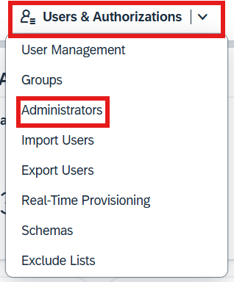

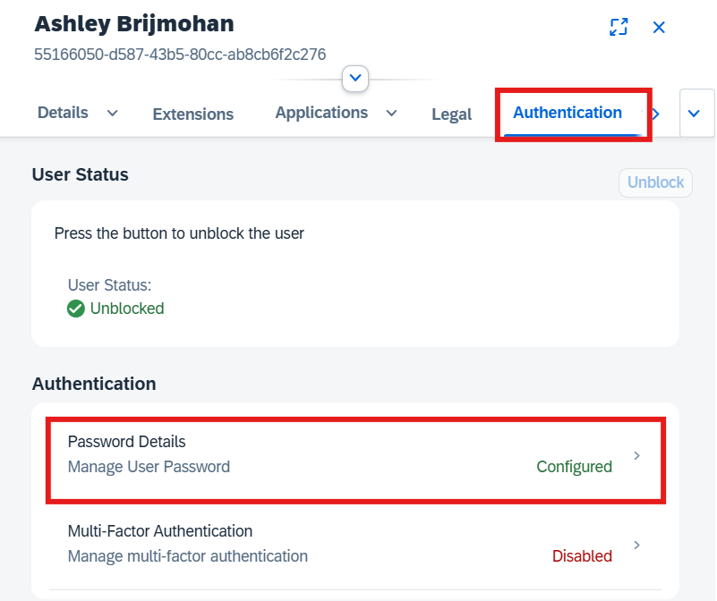
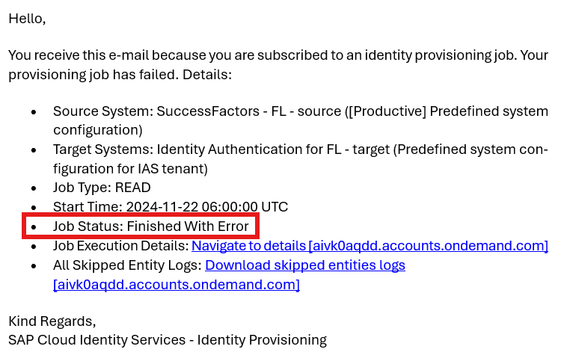
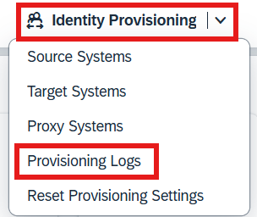
SuccessFactors: IAS Administration
Use this guide to aid in the administration and maintenance of the Identity Authentication Service for SuccessFactors. Note: IAS is used to ensure that our users are able to securely access SuccessFactors
IAS Link for Production
IAS Link for Test
Access the site – Note: all admins will need to be setup with an admin account for IAS
Create an Admin:
Users & Authorizations
Administrators
Click User
The Identifier should be your Foot Locker email address with “.admin” at the end, followed by entering in your first and last name
Configure all authorizations to match current admins
Once you have the admin user created, you need to reset their password manually; navigate to Users & Authorizations >User Management
Search for the new admin user and click on their profile
Click on Authentication > Password Details
Set an Initial Password, this will allow the user to login to the tenant now
Maintaining the IAS Tenant
As a best practice, it is advised to ensure that the number of users in User Management equates to the number of users in SuccessFactors.
Note: The count may off due to some users not having a unique Foot Locker email address in SuccessFactors. That is okay as those users do not access the system. You are looking to ensure the number of users with active email addresses matches the number of users in SuccessFactors with email addresses.
Email Notifications
Emails are received to the HRIS.SuccessFactors@footlocker.com inbox only if the IAS Tenant has an error that occurred in the daily user update cycle.
If a job finished with an error, you will need to review the error and try to troubleshoot it depending on the error.
Access the IAS Admin tenant > Identity Provisioning > Provisioning Logs
Review the log that finished with Errors and identify what the error message states in the Failed Entities.
Note: the logs will only show the last 30 days worth of logs in the Job Execution Logs

Slide 2
SuccessFactors: IAS Administration (continued)
Use this guide to aid in the administration and maintenance of the Identity Authentication Service for SuccessFactors. Note: IAS is used to ensure that our users are able to securely access SuccessFactors
Potential Errors and Troubleshooting
Helpful SAP Resource
Email is a duplicate
Work back in SuccessFactors and pinpoint the duplicate email account; may need to work with development to update the user import file or manually change the duplicate email address and inactive the duplicate if it was sent over mistakenly
No User Found
The user may not be active in SuccessFactors yet, wait until active date and recheck latest log to see if the status updated
Email has a unique accent mark from another language
Email Rizing to add in a transformation for the language to allow for that special character/letter to feed over to the logs
Submit a ticket to Rizing for any other inquiries if there are errors that cannot be resolved with our developer team/HRIS.

